Slide 1
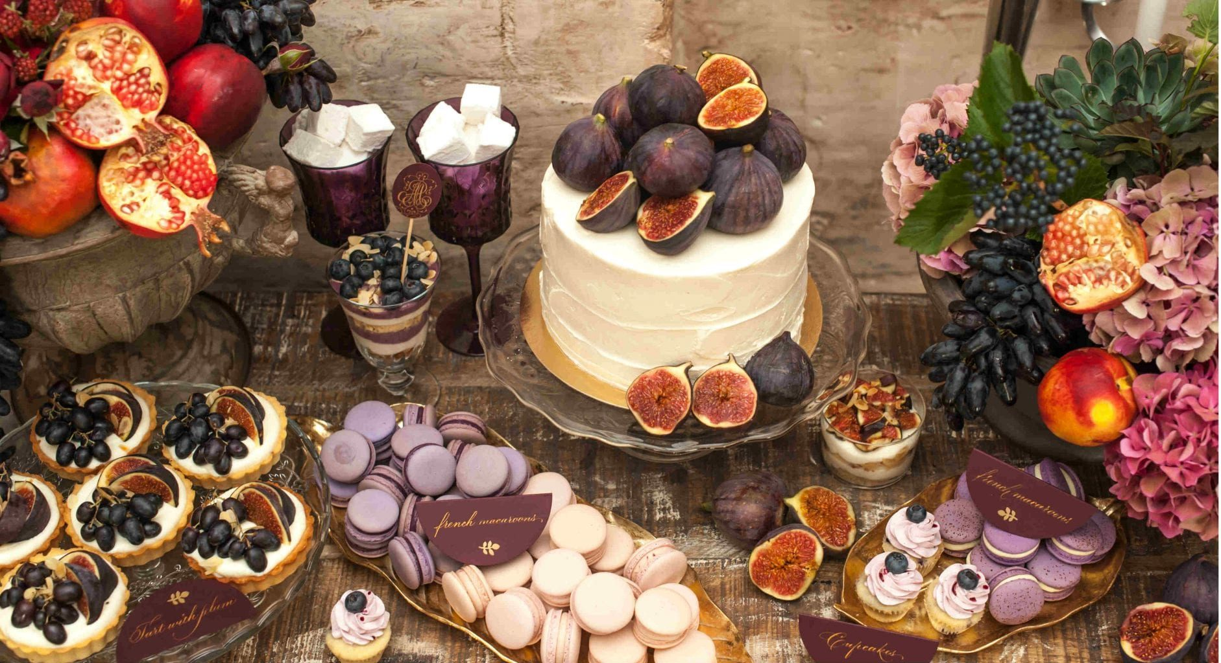
Parable of the
Wedding Feast
Matthew 22:1-14

Slide 2
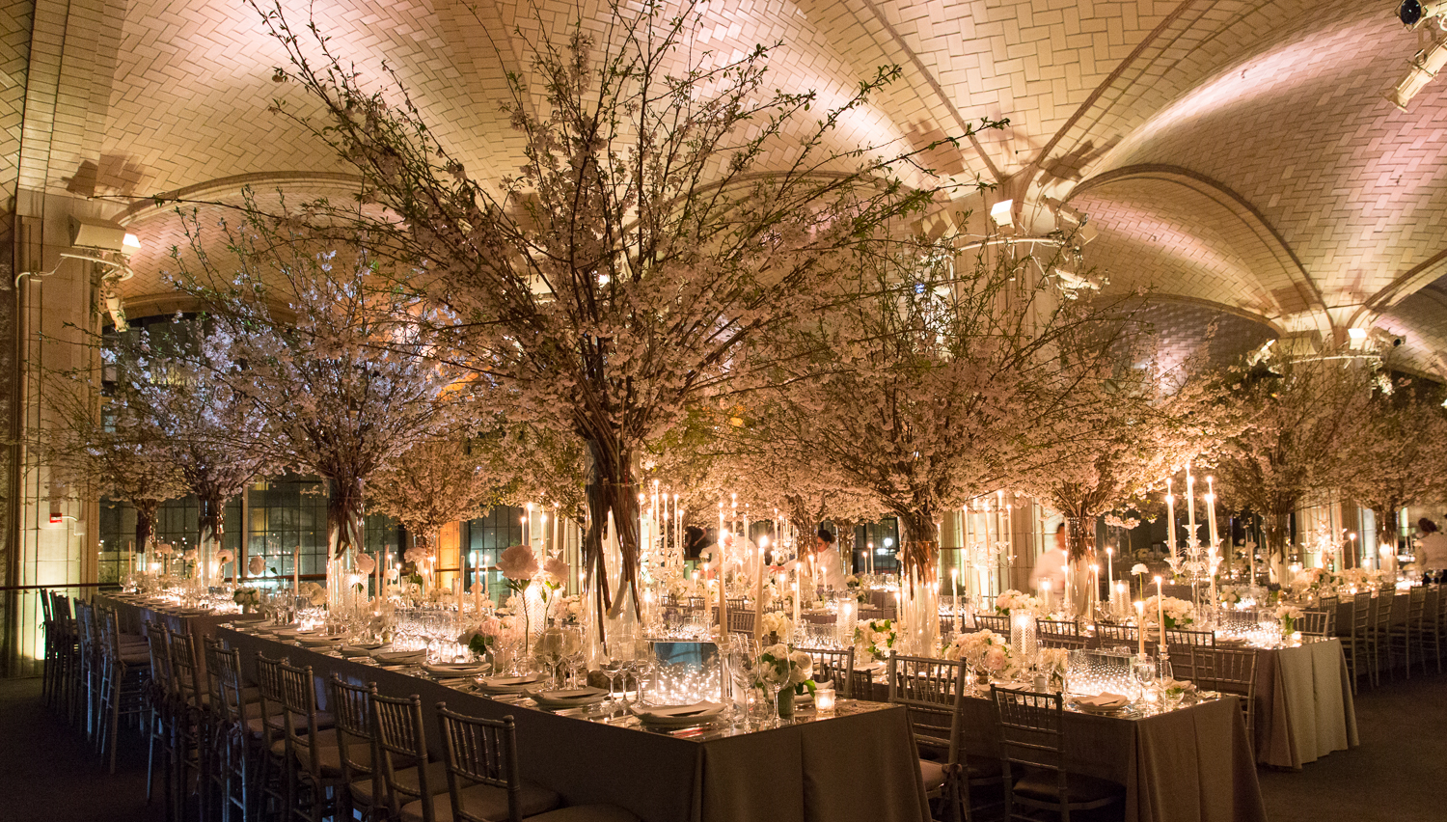
Part 4
Great Servants

Slide 3
In the parable of the Wedding Feast
Notice the willingness of the servants to be used in any capacity necessary to accomplish the king’s purpose
Some are asked to go
Stay and prepare – organize the workers, buy food, butcher the cattle, peal the potatoes, make salads, fruits, set up tables, do the decorations, prepare invitations with lists of names, contact them when everything was ready
Some have to be leaders while others do the actual work
  Bro Al mentioned at least 20 to 30 types of servants needed for TBC ministry to function
and sent out his servants to call those who were invited to the wedding; Mt 22:3a
Again, he sent out other servants, saying, ‘Tell those who are invited… Mt 22:4
And the rest seized his servants, treated them spitefully, and killed them. Mt 22:6
Then he said to his servants, ‘The wedding is ready, but those who were invited were not worthy. Mt 22:8
So those servants went out into the highways and gathered together all whom they found, both bad and good. And the wedding hall was filled with guests. Mt 22:10
Then the king said to the servants, ‘Bind him hand and foot, take him away, and cast him into outer darkness; there will be weeping and gnashing of teeth.’ Mt 22:13

Slide 4
In the parable of the Wedding Feast
Notice the willingness of the servants to be used in any capacity necessary to accomplish the king’s purpose
God desires that His servants serve without envy, strife, comparing
God does not want us to boast in our leaders or aspect of ministry
Each servant has their own unique giftings
We are all on the same team
Our rewards are based on our labors – not on our results
for you are still carnal. For where there are envy, strife, and divisions among you, are you not carnal and behaving like mere men? 1 Co 3:3
For when one says, “I am of Paul,” and another, “I am of Apollos,” are you not carnal? 1 Co 3:4
Who then is Paul, and who is Apollos, but ministers through whom you believed, as the Lord gave to each one? 1 Co 3:5
So then neither he who plants is anything, nor he who waters, but God who gives the increase. 1 Co 3:7
Now he who plants and he who waters are one, and each one will receive his own reward according to his own labor. 1 Co 3:8

Slide 5
In the parable of the Wedding Feast
Some servants are asked to serve with no little or no results
Remember that God does not forget our work or labor of love
and sent out his servants to call those who were invited to the wedding; and they were not willing to come. Mt 22:3
And he who reaps receives wages, and gathers fruit for eternal life, that both he who sows and he who reaps may rejoice together. For in this the saying is true: ‘One sows and another reaps.’ I sent you to reap that for which you have not labored; others have labored, and you have entered into their labors.” Jn 4:35–39
For God is not unjust to forget your work and labor of love which you have shown toward His name, in that you have ministered to the saints, and do minister. Heb 6:10

Slide 6
In the parable of the Wedding Feast
Some servants are asked to serve with no little or no results
Some servants are asked to serve where there is insult, injury, persecution and even death
Some are allowed to see God’s vengeance on those who bring persecution
Those who sacrifice and are persecuted will be greatly rewarded
But they made light of it … And the rest seized his servants, treated them spitefully, and killed them. Mt 22:5–6
But when the king heard about it, he was furious. And he sent out his armies, destroyed those murderers, and burned up their city. Mt 22:7
“Blessed are you when they revile and persecute you, and say all kinds of evil against you falsely for My sake. Rejoice and be exceedingly glad, for great is your reward in heaven, for so they persecuted the prophets who were before you. Mt 5:11–12

Slide 7
In the parable of the Wedding Feast
Some servants are asked to serve with no little or no results
Some servants are asked to serve where there is insult, injury, persecution and even death
Some are allowed to see God’s vengeance on those who bring persecution
Those who sacrifice and are persecuted will be greatly rewarded
In this life we are to bless, do good and pray for those who mistreat us
But I say to you, love your enemies, bless those who curse you, do good to those who hate you, and pray for those who spitefully use you and persecute you, Mt 5:44

Slide 8
In the parable of the Wedding Feast
Great servants are willing to do the work the way God asks that it be done
  That may be word for word
Again, he sent out other servants, saying, ‘Tell those who are invited, “See, I have prepared my dinner…all things are ready. Come to the wedding.” ’ Mt 22:4

Slide 9
In the parable of the Wedding Feast
Great servants are willing to do the work the way God asks that it be done
Most of the time God asks us to figure it out
  Seek God’s wisdom
  Be lead by the Spirit
  Ask for counsel
  Learn from others
  Learn from mistakes
  But figure it out --
Therefore go into the highways, and as many as you find, invite to the wedding.’ Mt 22:9
Go therefore and make disciples of all the nations, baptizing them in the name of the Father and of the Son and of the Holy Spirit, teaching them to observe all things that I have commanded you; and lo, I am with you always, even to the end of the age.” Amen. Mt 28:19–20
But you shall receive power when the Holy Spirit has come upon you; and you shall be witnesses to Me in Jerusalem, and in all Judea and Samaria, and to the end of the earth.” Ac 1:8
So he called ten of his servants, delivered to them ten minas, and said to them, ‘Do business till I come.’ Lk 19:13

Slide 10
In the parable of the Wedding Feast
These servants “figured it out”
  They were to “invite” = call
  They “gathered”
  They were not given specific instructions about the type of people to invite, so they invited all
    If God has not given a specific restriction, lets err on the side of filling the banquet hall with guests
  Their message must have been filled with urgency
  They caught the vision of reaching people
So those servants went out into the highways and gathered together all whom they found, both bad and good. And the wedding hall was filled with guests. Mt 22:10
For whom He foreknew, He also predestined to be conformed to the image of His Son, that He might be the firstborn among many brethren. Ro 8:29

Slide 11
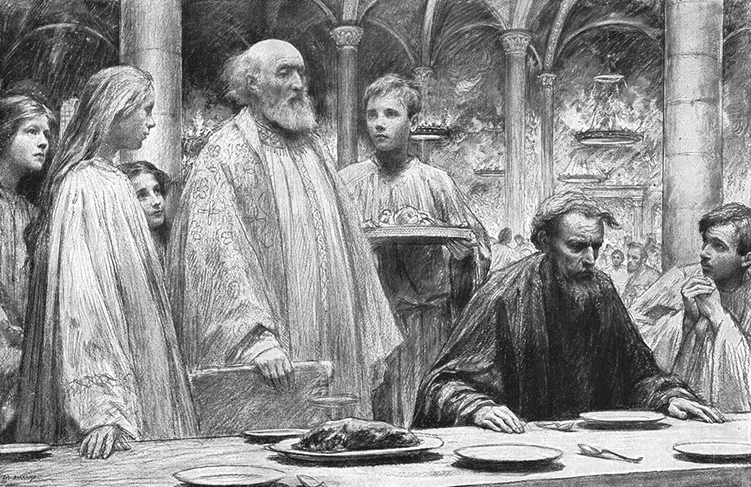
So he said to him, ‘Friend, how did you come in here without a wedding garment?... Mt 22:12a
“How…?”–Not “Why…?”
I know my servants would have given you a garment
I know my servants would have told you how important this is to me
How did you come in…
“By the Rivers of Babylon”
Psalm 137

Slide 12

Consider the response:
He could not answer because:
  The true answer was:
    “Oh, your servants made it very clear to me that you expected all guests to put on your wedding garment”
    “But, I don’t really care what you think, king”
    “I told your servants to stand back and get out of the way because I alone will decide what garment I will wear”
    “No king is going to tell me what to do”
…‘Friend, how did you come in here without a wedding garment?’ Mt 22:12a
And he was speechless. Mt 22:12b

Slide 13
Notice the humble obedience of the servants to “invite”, “gather together”, give out wedding garments and even “compel” but not use force to impose the king’s expectation
Our methods in this age are love and truth
Another parable He put forth to them, saying: “The kingdom of heaven is like a man who sowed good seed in his field; but while men slept, his enemy came and sowed tares among the wheat and went his way. Mt 13:24–25
…The servants said to him, ‘Do you want us then to go and gather them up?’ Mt 13:28
But he said, ‘No, lest while you gather up the tares you also uproot the wheat with them. Mt 13:29
Let both grow together until the harvest, and at the time of harvest I will say to the reapers, “First gather together the tares and bind them in bundles to burn them, but gather the wheat into my barn.” ’ ” Mt 13:30

Slide 14
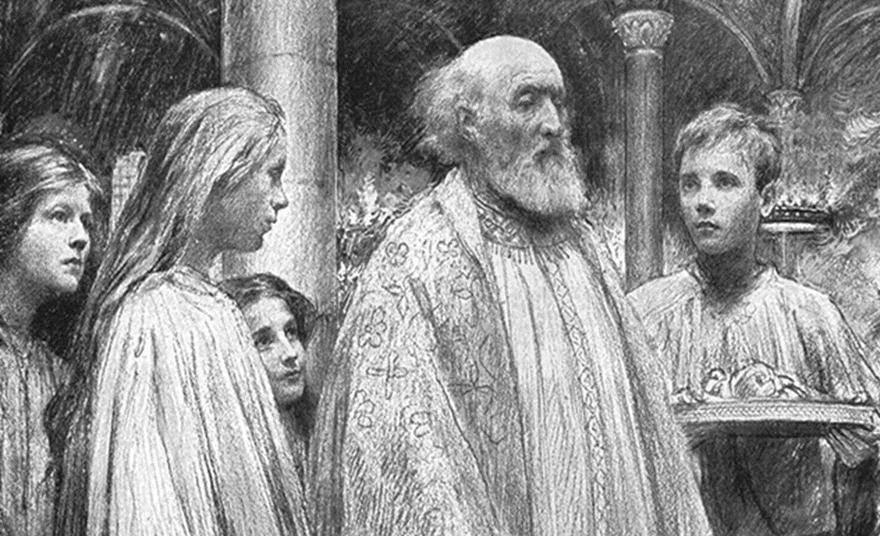
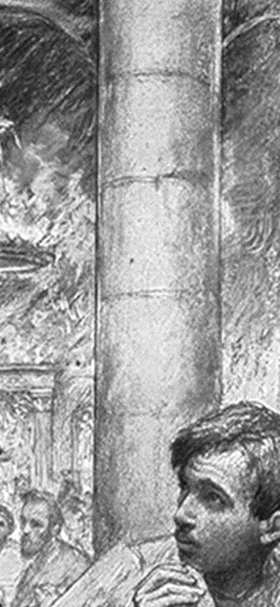
Consider the Servants
Humility is the key to being a great servant of God
They did whatever the king asked
They did not give up or quit when people did not respond to their invitation

Slide 15
Consider the Servants
They did not take offense when the king tried other servants
They did it the way the king asked
They were willing to be mistreated and even die for the king
They were willing figure out how to accomplish the goal of reaching people

Slide 16
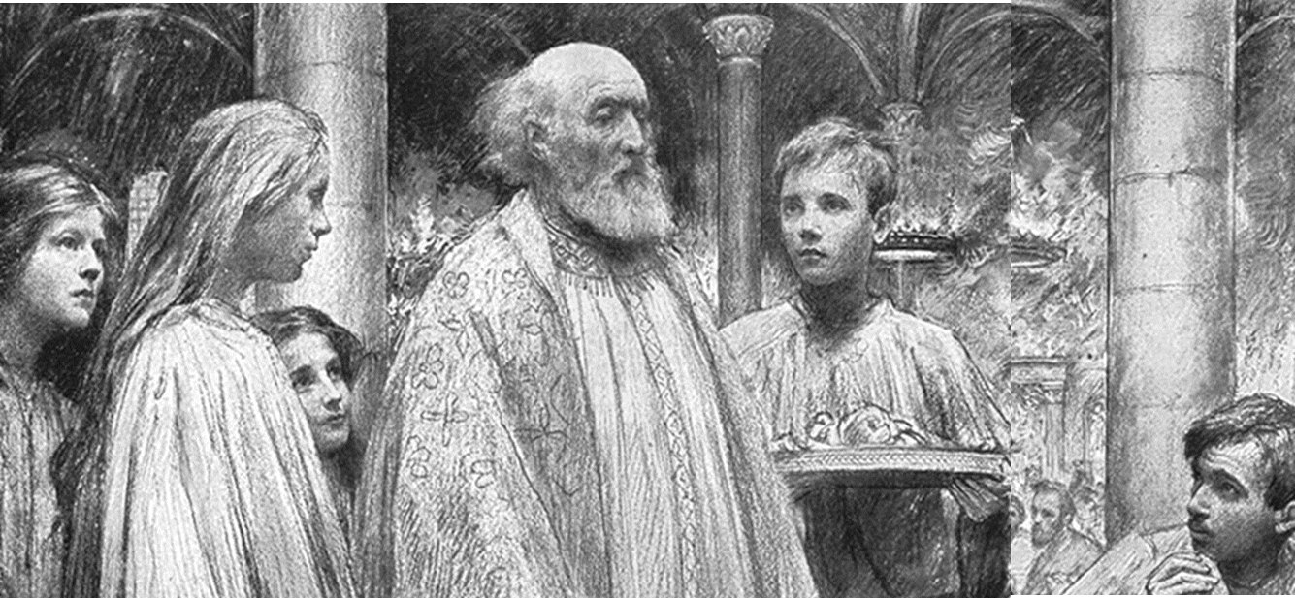
What can we do?
Be a servant
Be flexible and useable to God
Be willing to be used by God to fill the house with guests
Figure it out. Use whatever method you can that is not against God’s clear revelation
Be an encouragement to those around you
Be a disciple maker
Then he said to his servants, …Therefore go into the highways, and as many as you find, invite to the wedding.’ Mt 22:8–9
And the wedding hall was filled with guests. Mt 22:10
‘Do business till I come.’ Lk 19:13

Slide 17
Dear Savior! when before Thy bar
All tribes and tongues assembled are,
Among Thy chosen will I be,
At Thy right hand— complete in Thee.
“For many are called, but few are chosen.” Mt 22:14

